Slide 1
gROUP 6
PRESENTATION

Slide 2
Jamhuriya University - Cloud Infrastructure Project
Group 6 CNS222 July 2026

Slide 3
Problem Statement
Registration week: servers crashed, students couldn't register.
Data was on ONE server with NO backup fire or flood would wipe everything out.
Storage was full. Remote access barely worked. And anyone could see any data because there was no MFA or access control.

Slide 4
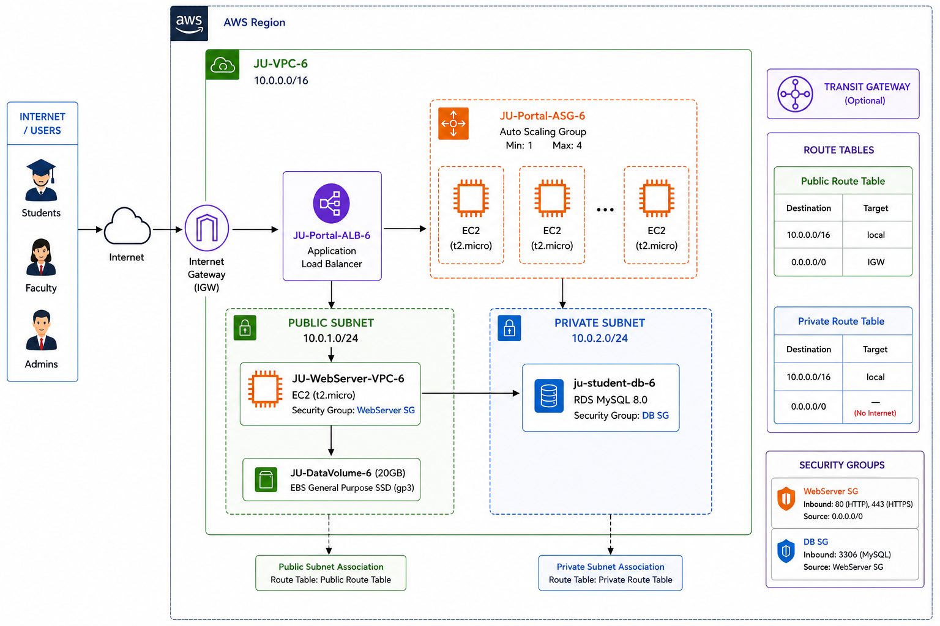
Solution Overview
Built secure, scalable,
highly available AWS infrastructure in af-south-1 (Cape Town)

Slide 5
VPC & Networking
We created a VPC with two subnets:
Public Subnet: Web server (EC2) with internet access
Private Subnet: Database (RDS) with NO internet access
We attached EBS storage and created 3 S3 buckets for files. The load balancer + Auto Scaling handles traffic spikes automatically

Slide 6
Security
IAM controls access Admins have full access,
Faculty can upload, Students can only view.
MFA protects admin accounts.
The database is in a private subnet, completely isolated from the internet.

Slide 7
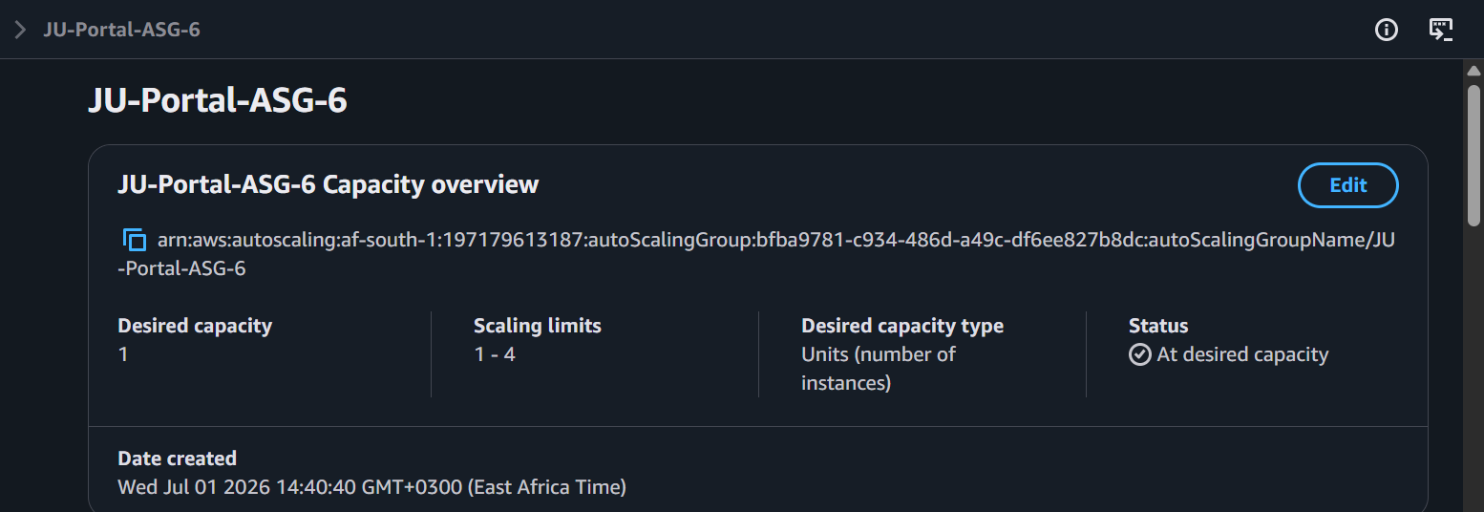
Auto Scaling
When CPU exceeds 60%, Auto Scaling adds servers.
When it drops below 20%, it removes them. Min 1, Max 4.

Slide 8
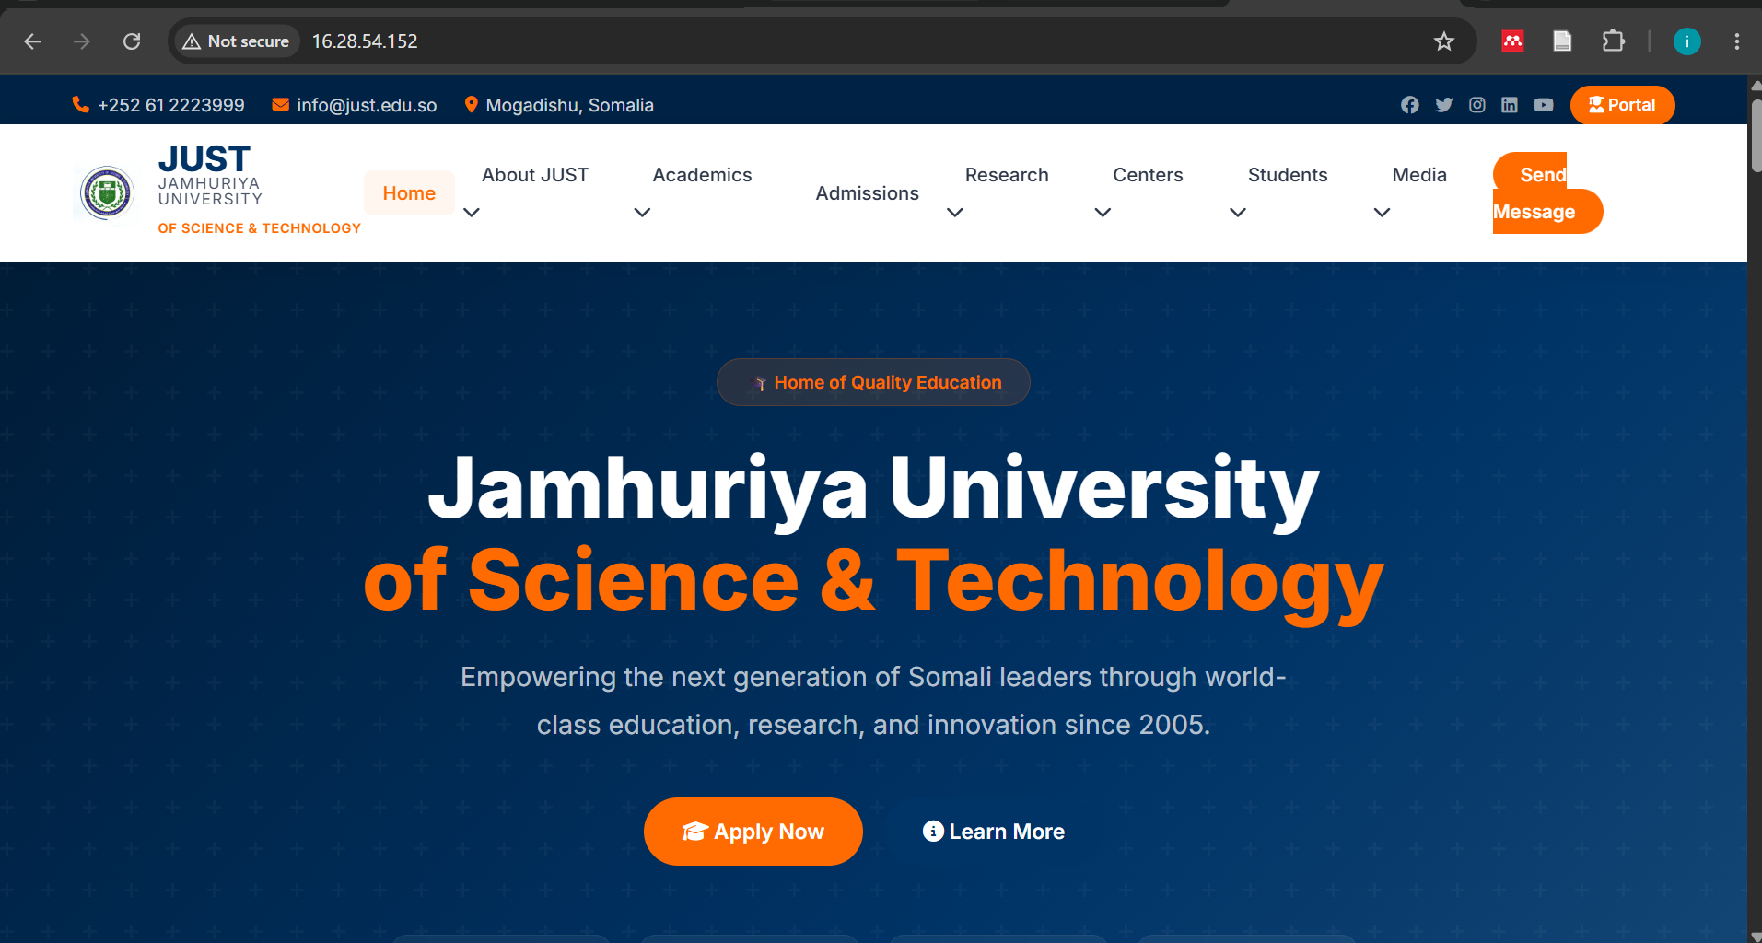
Live Demo Portal

Slide 9
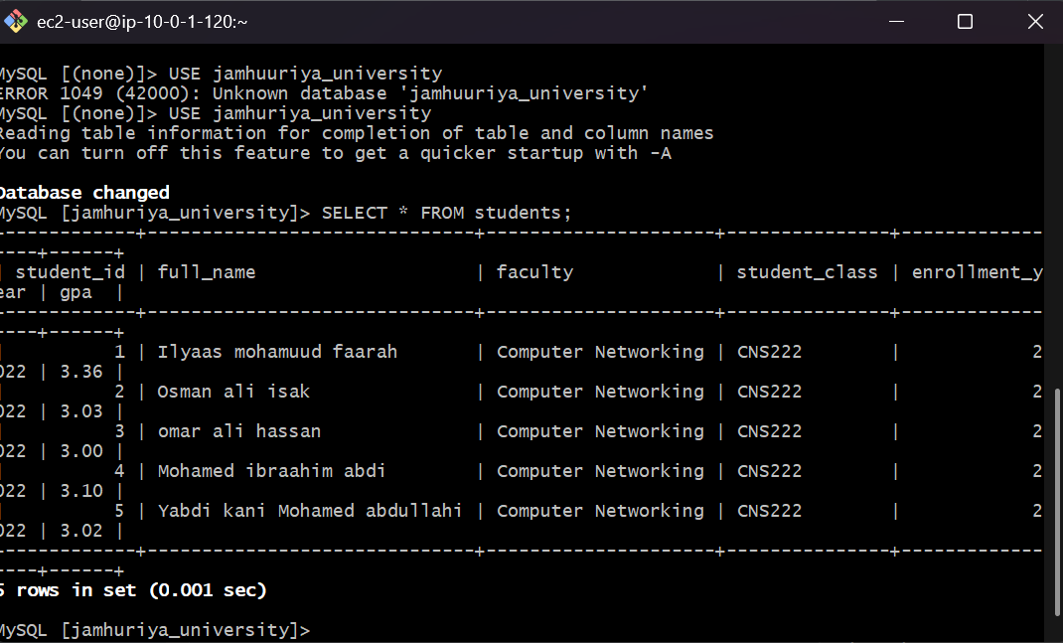
Live Demo Database

Slide 10
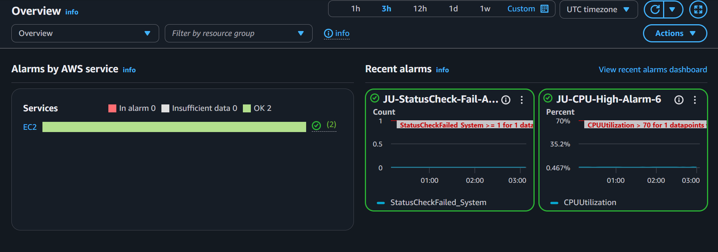
Live Demo: Monitoring

Slide 11
Challenges
We had issues: Bahrain region outage switched to Cape Town.
RDS required 2 Azs added another subnet.
SSH timeouts fixed by adding our IPs to the security group

Slide 12
Results
JUST now has zero downtime during registration,
secure backed-up data, unlimited storage,
24/7 monitoring, and enterprise security all for under $50/month.
Scalable for the next 10 years.

Slide 13
Team & Thank You
Group 6: Cloud Admin, Security Engineer, Security Assistant,
Infrastructure Engineer, Network Engineer, Database Engineer,
Storage Engineer, and Monitoring Lead.

Slide 14
END

